Slide 1
Syracuse Housing Code Violations Dashboard

Slide 2

01
Housing conditions impact safety and quality of life
02
Data exists but is difficult to interpret
Project Overview
03
Focus on violations, patterns, and system performance
04
Stakeholder-focused civic insights
05
Dashboard for real-world usability

Slide 3

Problem & Research Question
The Problem
Housing conditions directly affect safety, neighborhood stability, and quality of life. While Syracuse provides open data on code violations, the raw dataset is difficult to interpret without structured analysis and visualization.
Research Question
This project asks how violations are distributed across neighborhoods and time, and what patterns in violation type, case status, and resolution time reveal about system performance.
Why It Matters
Clear interpretation of this data enables stakeholders to understand community needs, evaluate performance, and make informed decisions that improve housing conditions.

Slide 4

Data & Challenges
Dataset Overview
The analysis uses the Syracuse Open Data Code Violations dataset, containing over 143,000 records with details on violation type, status, dates, and neighborhood location.
Data Quality Issues
Challenges include missing values, inconsistent formatting, and mixed date fields. Additionally, violation reporting is complaint-driven, which introduces bias in how issues are captured.
Implications
These limitations require careful interpretation. The analysis focuses on descriptive patterns rather than causal conclusions, ensuring responsible use of civic data.

Slide 5

Approach & Methodology
Analysis Pipeline
The project follows a structured pipeline from raw data to cleaned datasets, analysis, validation, and final dashboard output. Each step is modular to ensure reproducibility and clarity.
Techniques Used
Data cleaning, feature engineering, and aggregation were performed using Python and Pandas. Key features include year, case status, and resolution time for analysis.
LLM Validation
LLMs were used only for documentation and narrative support. All insights and findings were validated using computed statistics to ensure accuracy and avoid hallucinations.

Slide 6
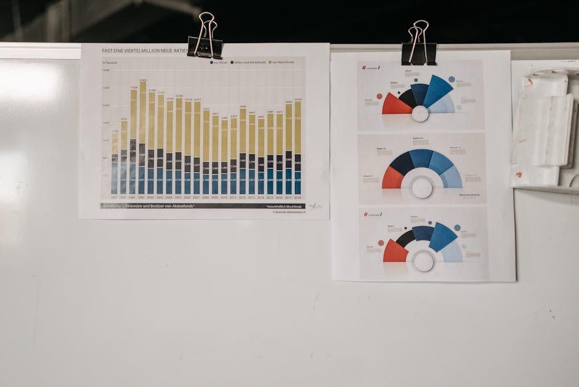
01
Violations concentrated in specific neighborhoods
02
Few violation types dominate
Key Findings Overview
03
Trends increase over time
04
Most cases resolved but backlog exists
05
Resolution time varies across neighborhoods

Slide 7
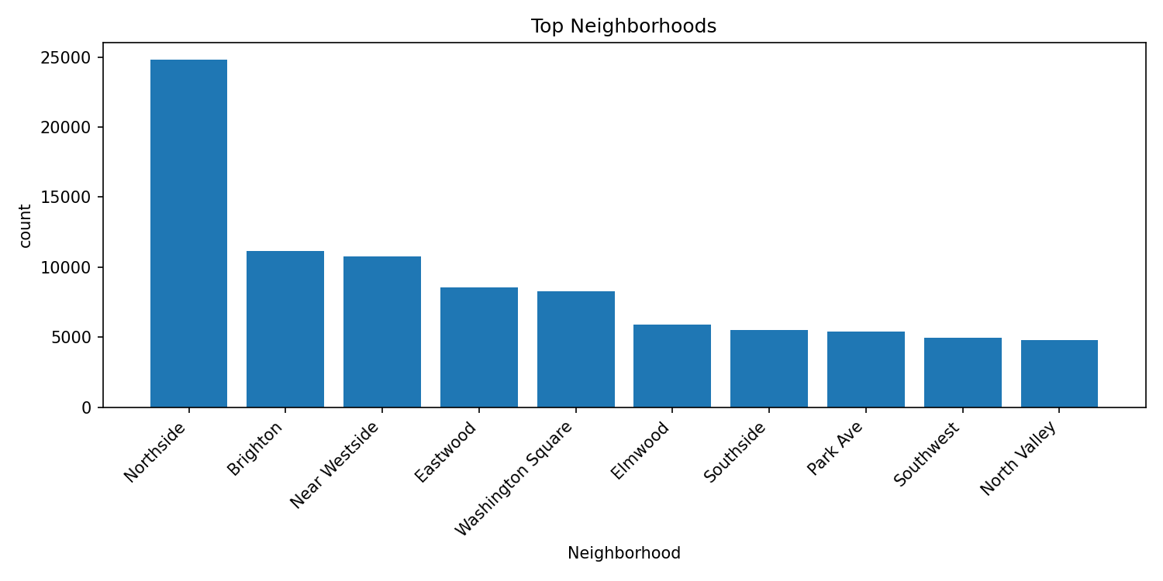
Neighborhood Patterns
Observation
Violations are heavily concentrated in specific neighborhoods such as Northside, Brighton, and Near Westside. This uneven distribution highlights areas with higher housing challenges.
Interpretation
The concentration may reflect differences in housing conditions, enforcement, or reporting behavior. These patterns suggest the need for targeted attention in specific areas.
Impact
City officials can use this insight to allocate resources, prioritize inspections, and design interventions for neighborhoods with the highest needs.

Slide 8
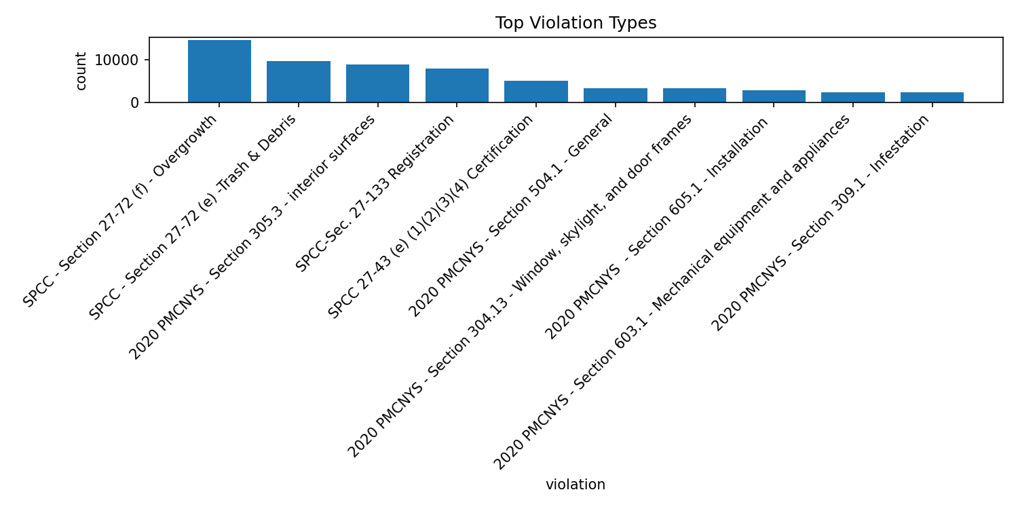
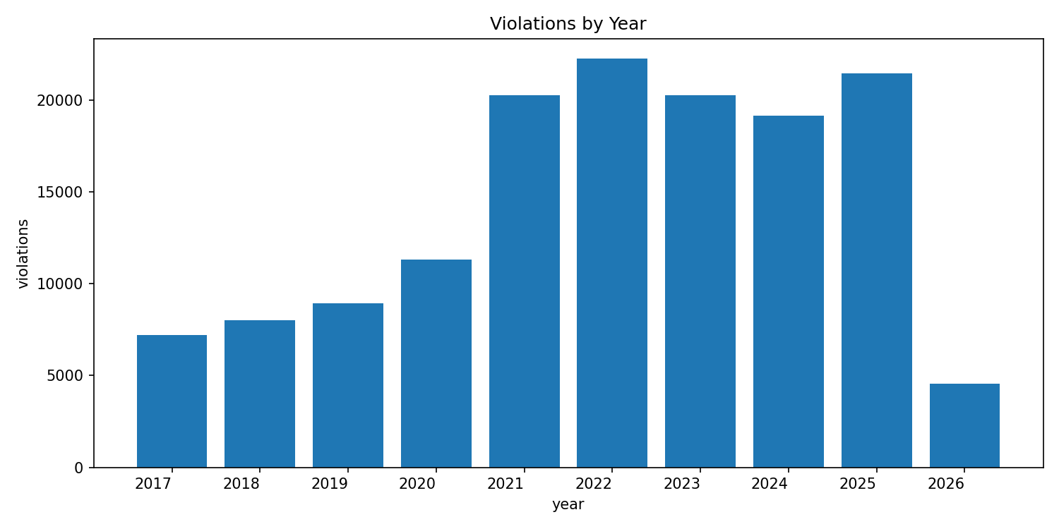
Violation Types & Trends
Key Patterns
A small number of violation types, particularly overgrowth and trash-related issues, account for a large share of all reported cases. This indicates recurring problems rather than isolated incidents.
Trends Over Time
The number of violations has increased over time, peaking around recent years. This may reflect changes in reporting, enforcement, or actual housing conditions.
Impact
Addressing the most common violation types could significantly reduce total cases and improve overall neighborhood conditions.

Slide 9
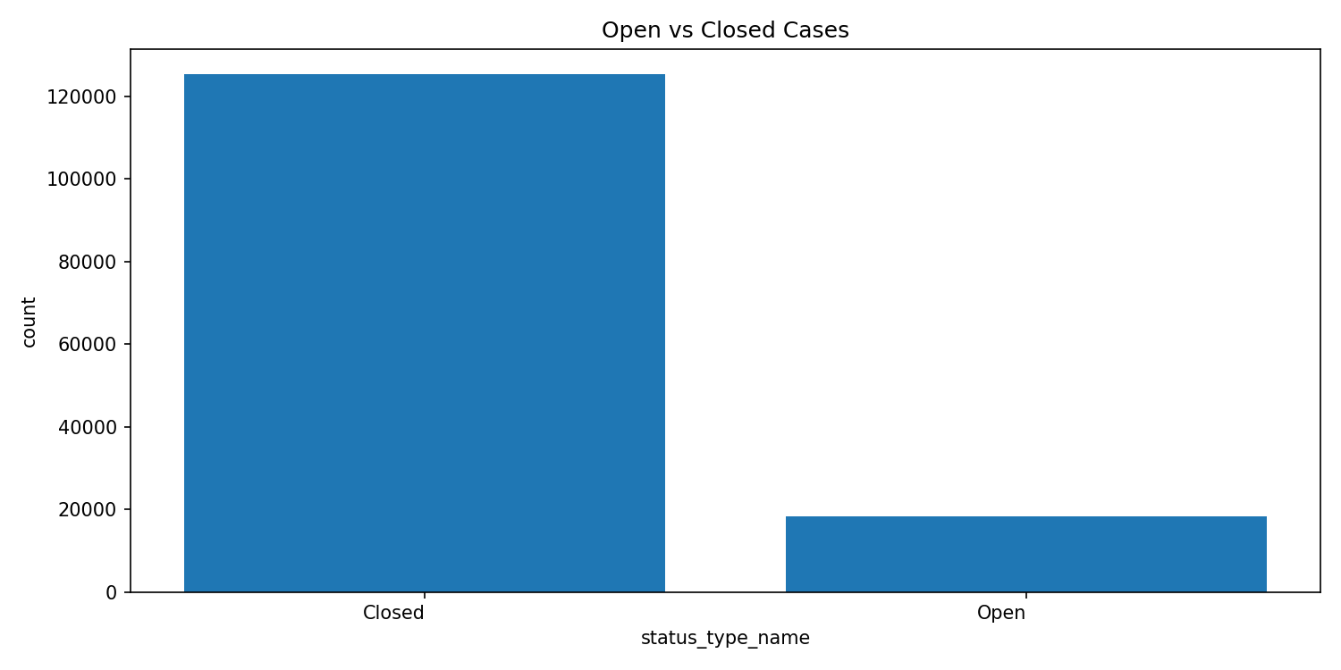
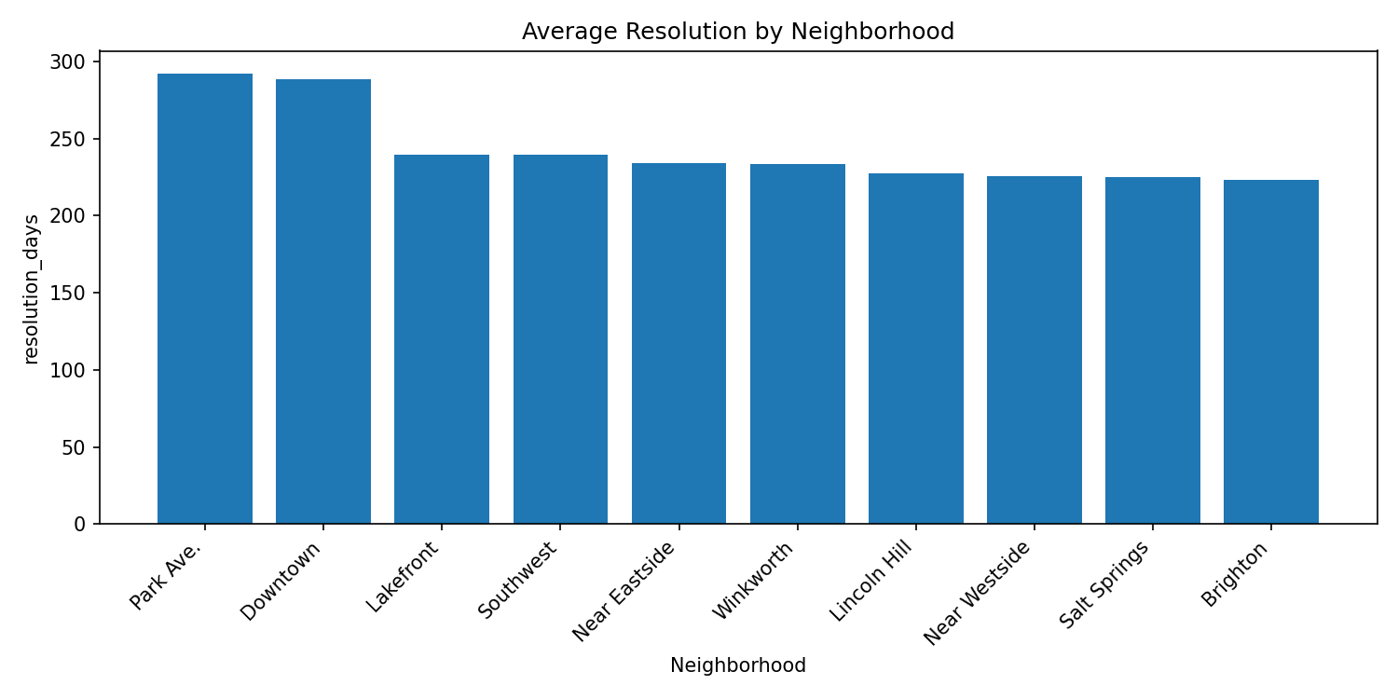
System Performance
Case Status
Most violations are eventually resolved, with a majority of cases marked as closed. However, a notable number of open cases remain, indicating ongoing workload.
Resolution Time
Resolution time varies across neighborhoods, suggesting differences in service efficiency or case complexity. Some areas experience longer delays than others.
Impact
Improving resolution time and reducing open cases can enhance public trust and ensure more equitable service delivery across the city.

Slide 10

Limitations & Responsible Interpretation
Key Limitations
The dataset reflects reported violations rather than all housing issues. Complaint-driven reporting and inconsistent data quality can introduce bias and affect comparisons across neighborhoods.
Interpretation Approach
This analysis focuses on descriptive patterns rather than causal relationships. Findings are presented with caution to avoid overgeneralization or misleading conclusions.
Future Work
Future improvements could include integrating additional datasets, improving data quality, and developing predictive models to support proactive decision-making.

Slide 11
Impact
What value does this project provide?
Conclusion & Civic Impact
This project transforms Syracuse open data into clear, actionable insights that support residents, policymakers, and community organizations. By improving transparency and highlighting patterns in housing conditions, it contributes to better-informed decision-making and more effective city services.

